Slide 1
Version Control
V1
V2
V3
Versi..
Version Con..
Matt Petersen

Slide 2
What is version control
Version control, also known as source control, is a system that tracks and manages changes to files over time.
It is an essential tool in software development, enabling teams to collaborate, maintain a history of changes, and ensure code integrity.
Developers can work on the same project simultaneously without conflicts, revert to previous versions, and experiment with new features in isolated environments.

Slide 3


The Basics
Git –helps you manage changes to your code over time. It keeps track of every change made. You can look at previous versions or undo mistakes if needed. (This is the standard tool development)
Repositories – (or Repos) are a central hub where all your work is stored.
Local – Your computer, where you work on your project and changes.
Remote – A remote server that stores all changes made by everyone

Slide 4
The Basics
Commits: Every time you make changes and save them in Git, these are called commits.
Branches: A repository allows you to create Branches and work on new features and fixes.
Merging: Once you are done with the branches you have made, you can merge those branches into main branch.
Cloning: Cloning is a process of making a complete copy of Git repository.

Slide 5
Getting Started
Install Git. Git - Install
Create a GitHub account. https://github.com
Configure Git – Open a command prompt and type:
git config --global user.name "Your GitHub Username"
git config --global user.email “Your GitHub your.email@example.com"
Install the ‘GitHub Pull Requests’ extension in VSCode
https://marketplace.visualstudio.com/items?itemName=GitHub.vscode-pull-request-github

Slide 6
Using Git, Github & VSCode - DEMO
Initialising a local Git repository
Publishing to GitHub
Making changes locally (commit)
Publishing changes to GitHub (push)
Reviewing history and reverting changes
Clone a repository locally

Slide 7
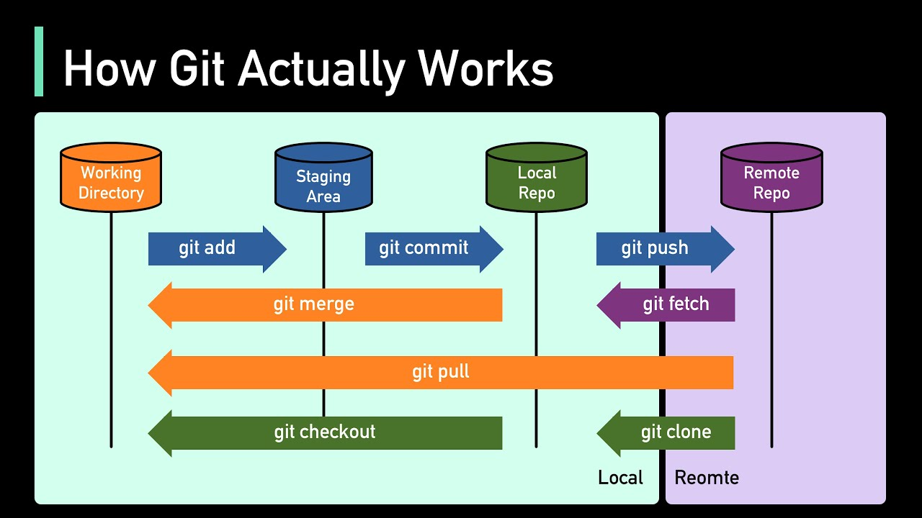
Reference

Slide 8
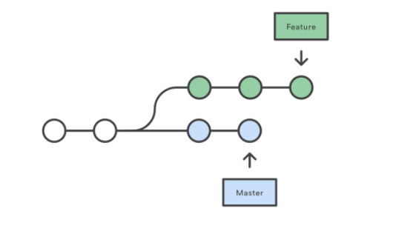
Reference - Branches

